Slide 1

Traffic Route Prediction
Ujwala Dama
Sri Manvitha Malampati
Shreelaasya Vejandla
Navayasri Yarramreddy

Slide 2
Problem statement
Many big cities experience traffic problems, particularly during some of the busier times of the day. It may be possible to take action to ease traffic on some roads if popular and alternative routes are continuously checked for traffic. There are many uses and benefits for real-time traffic simulation and prediction.
In this project we are working on the traffic congestion
DATA COLLECTION
we have utilized traffic congestion dataset which can be downloaded from below KAGGLE URL https://www.kaggle.com/competitions/tabular-playground-series-mar-2022/data?select=train.csv
The columns we used from this data set
row_id
time
direction
congestion
X,Y Values- latitude and longitude

Slide 3
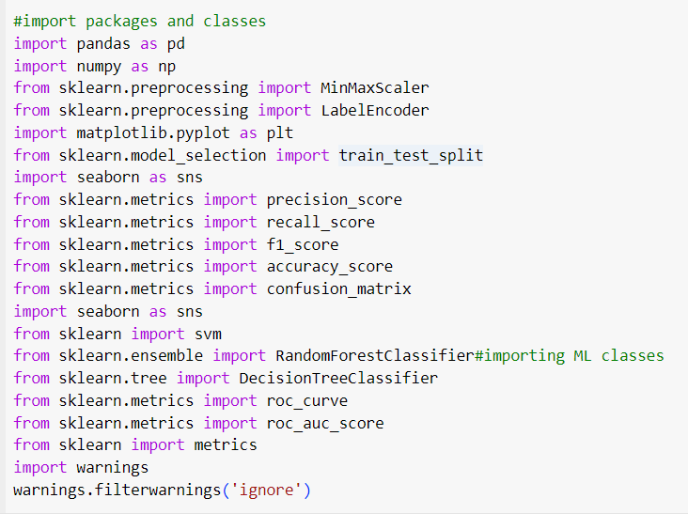
Data Cleaning and Exploration step 1:- importing all the packages

Slide 4
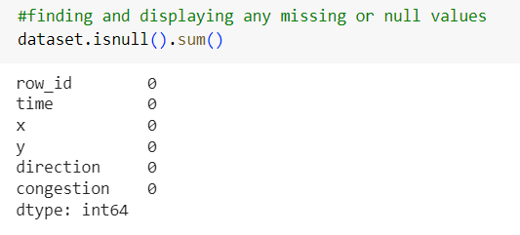
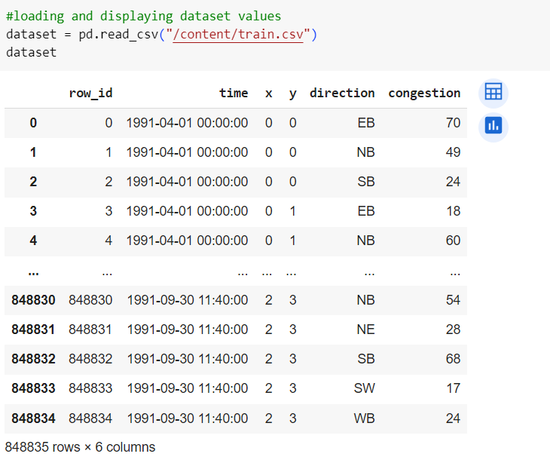
Step 2 :- loading data and cleAnsing the data

Slide 5
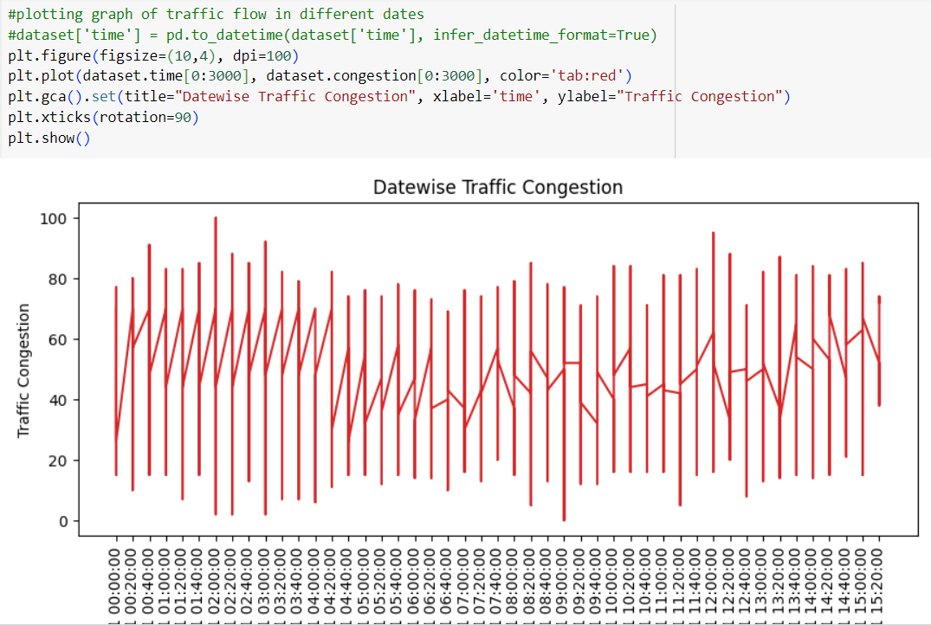
Step 3 :-In this graph displaying traffic congestion on different dates where x-axis represents Date and y-axis represents traffic congestion

Slide 6
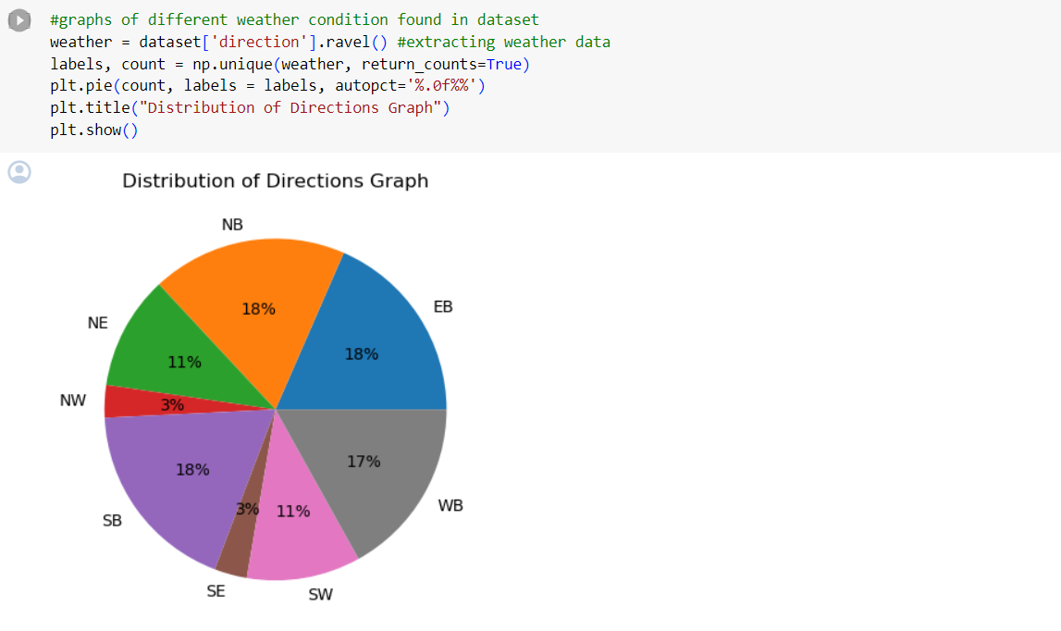
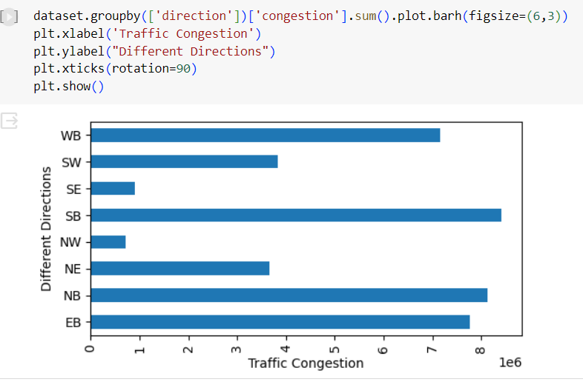
Step 4:-In this pie graph we are finding percentage of different directions or route exists in the dataset AND in second graph we are finding sum of traffic exists in each direction where x-axis represents traffic count and y-axis represents direction

Slide 7
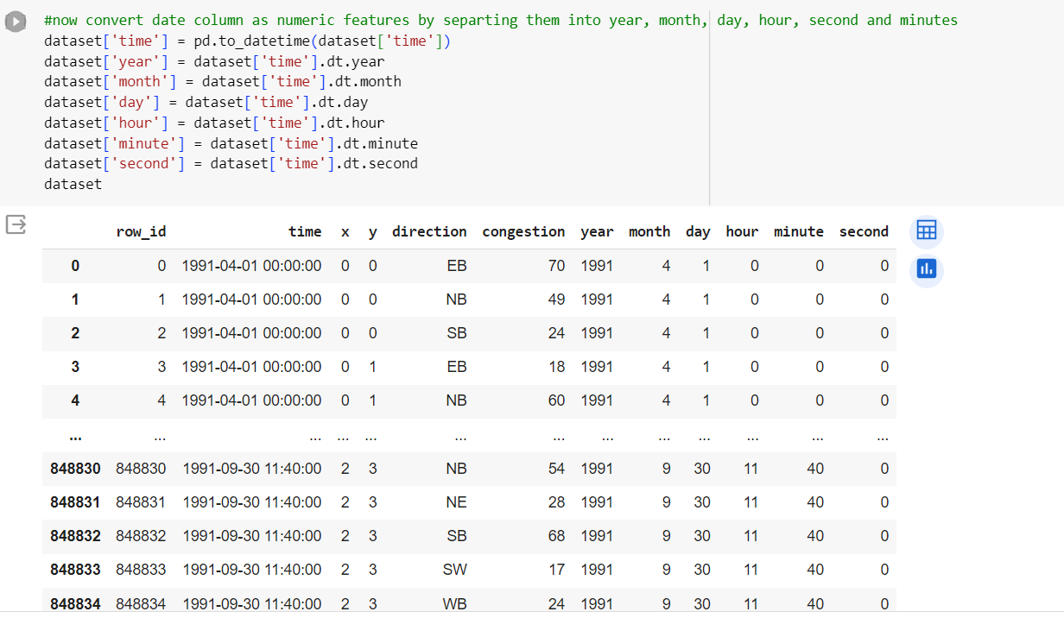
DATA PREPROCESSING step 1:- we are processing dataset to convert date into Day, Month and Year format so we can analyze traffic day or month wise and in above output we can see now dataset has day, year and month columns

Slide 8
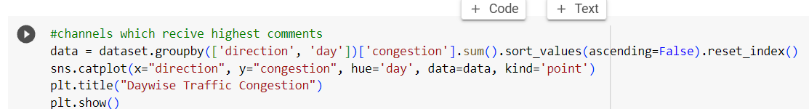
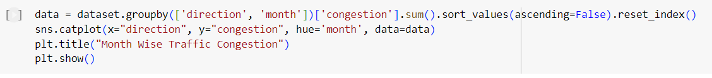
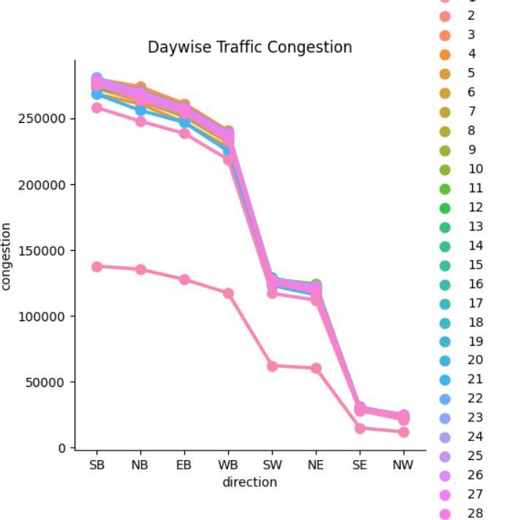
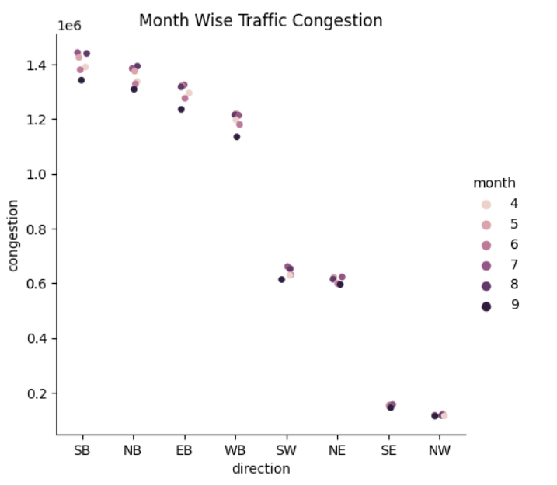
Step 5:- for graph 1 above graph we are finding traffic day wise and each different color line represents different days traffic where x-axis is the direction and y-axis is the traffic congestion count

Slide 9
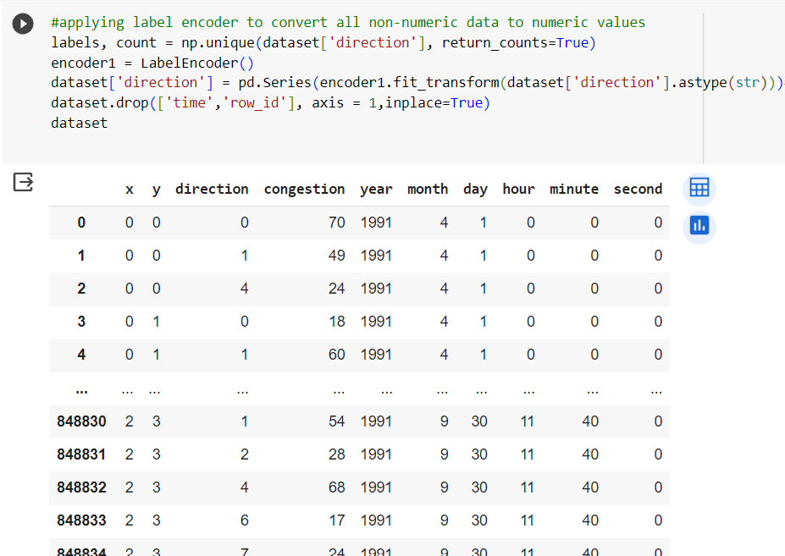
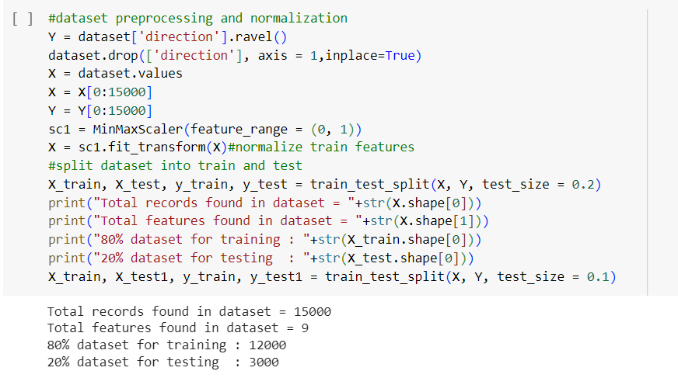
Step6:- This step includes converting direction to the numeric values and data preprocessing and normalizing as we taken 15000 data and these are divided into test and train data where it is divided into 80% and 20 %.

Slide 10

MODEL SELECTION,TRANNING AND EVALUATION
WE IMPLEMENTED 3 DIFFERENT KIND OF MODELS
Support Vector Machines (SVM)
decision tree
Random Forest

Slide 11
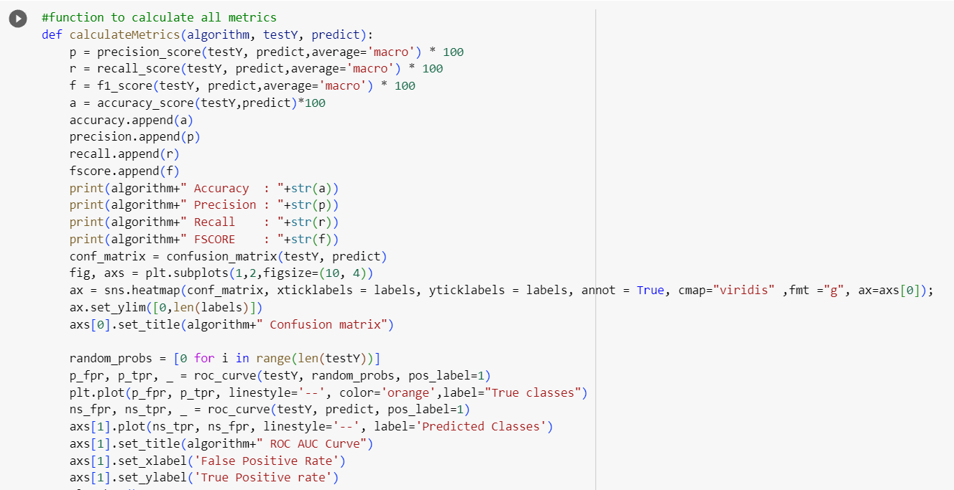
METRIX CREATION

Slide 12
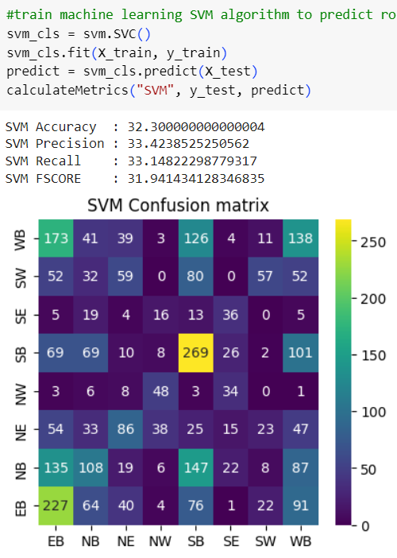
TRANING AND EVALUATING SVM

Slide 13
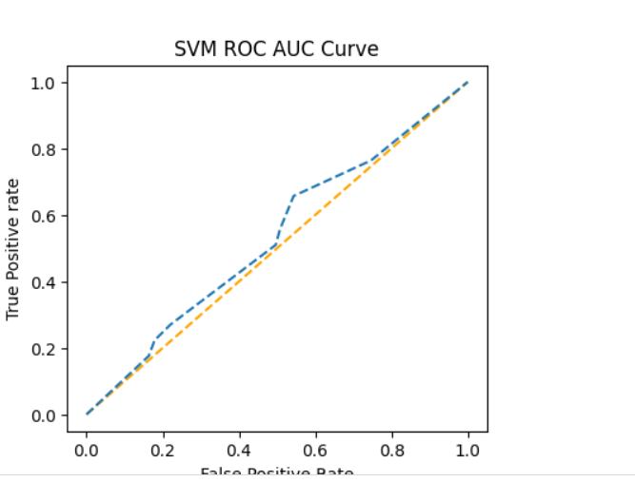
EVALUATING SVM BY ROC AUV CURVE

Slide 14
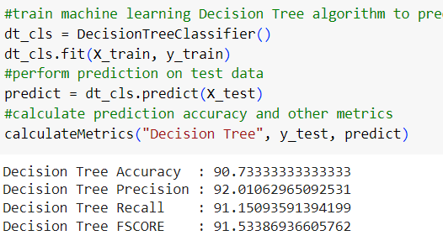
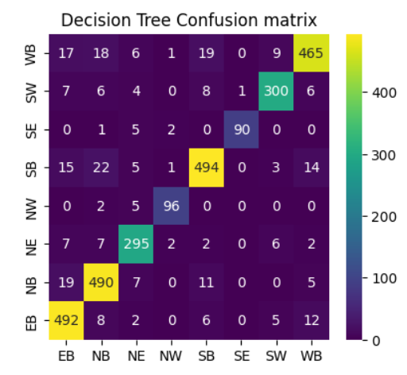
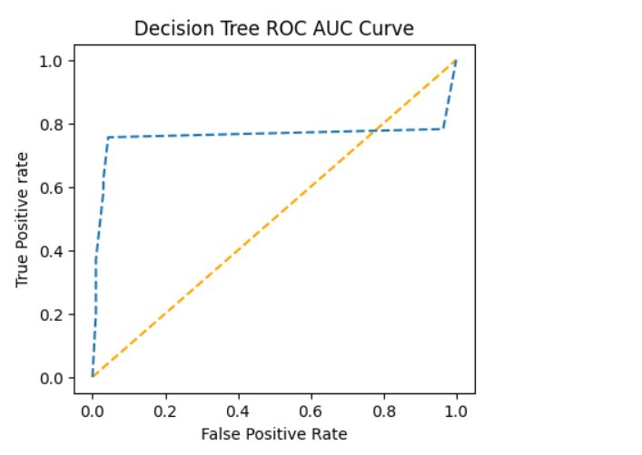
TRANING AND EVALUATING DESSION TREE

Slide 15
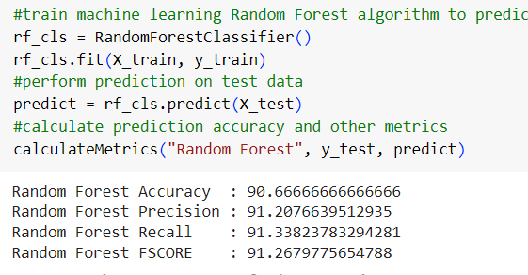
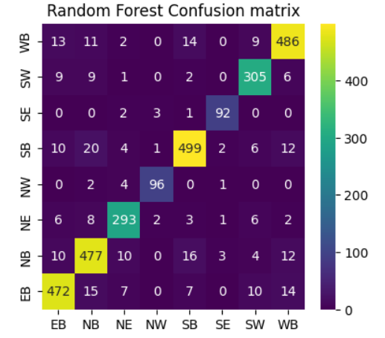
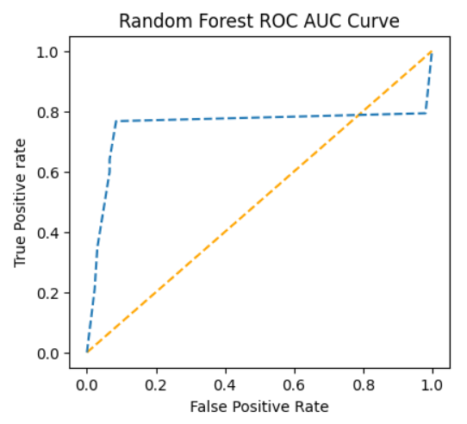
TRANING AND EVALUATING RANDOM FOREST

Slide 16
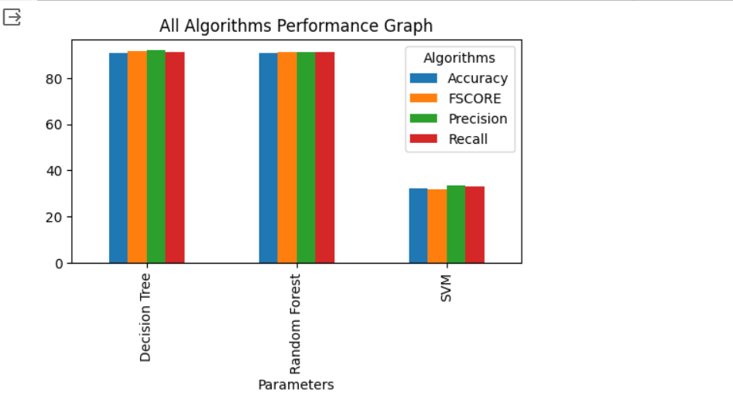
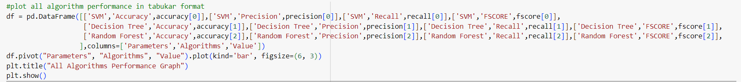
PERFORMANCE COMPARISION GRAPH

Slide 17
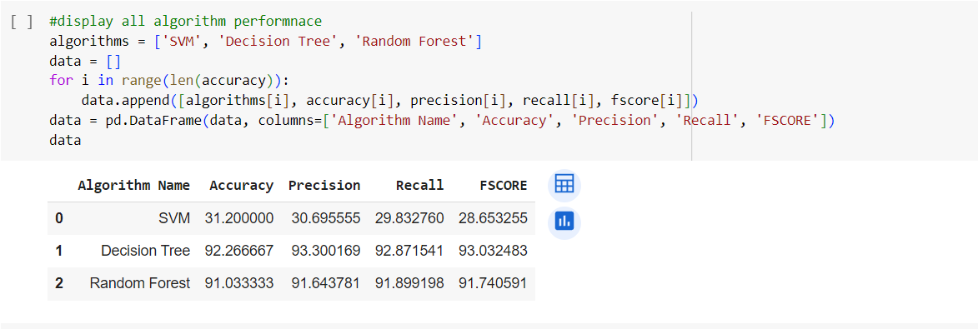
IMPLEMENTING IN TABULAR FORMAT

Slide 18
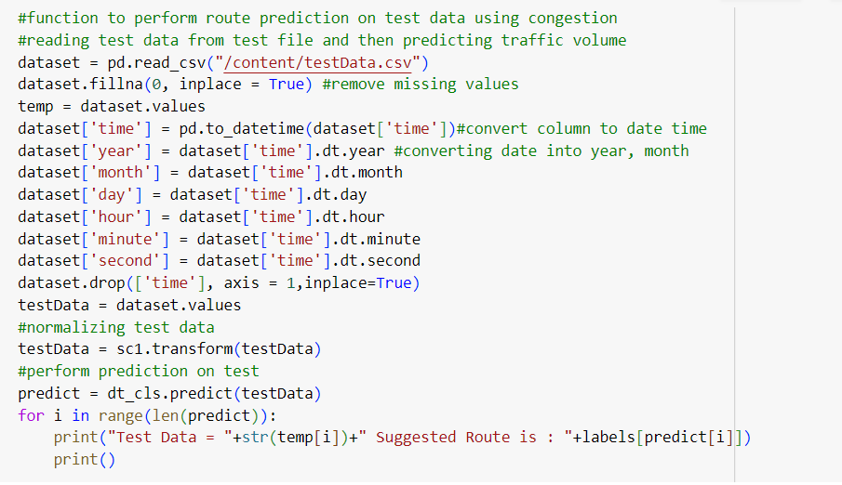
IMPLEMNTING BY USING TEST DATA STEP 1:- READING TEST DATA AND PERFORMING ANALYSIS

Slide 19
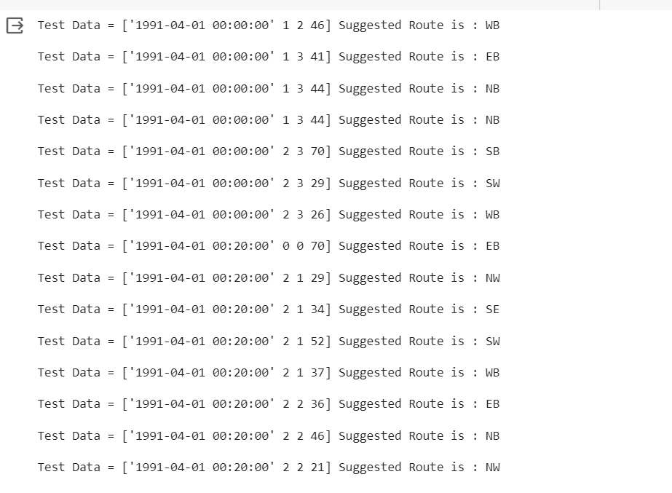
In this we are defining function to read TEST data and then perform route prediction on test and after execution above block will get below output

Slide 20
Conclusion
In above predictions in square bracket we can see the TEST data where last value is traffic congestion and based on that congestion we can see suggested Route as WB or NB or SE

